Slide 1


Pesti-Gen: Unleashing a Generative Molecule Approach for Toxicity Aware Pesticide Design
Taehan Kim and Wonduk Seo
Speaker: Wonduk Seo (Peking University) Co-Author: Taehan Kim (University of California, Berkeley)
Paper Link: https://arxiv.org/abs/2501.14469

Slide 2
1. Introduction
Pesti-Gen: Unleashing a Generative Molecule Approach for Toxicity Aware Pesticide Design
Global reliance on pesticides due to climate change
Risks: (1) Health hazards and (2) ecological damage
Motivation: Need for eco-friendly pesticides

Slide 3

2. Current Challenges in Pesticide Development
Taehan Kim and Wonduk Seo
Toxicity concerns (livestock and aquatic)
Regulatory constraints (e.g., neonicotinoids ban)
Environmental variability affecting pesticide effectiveness

Slide 4

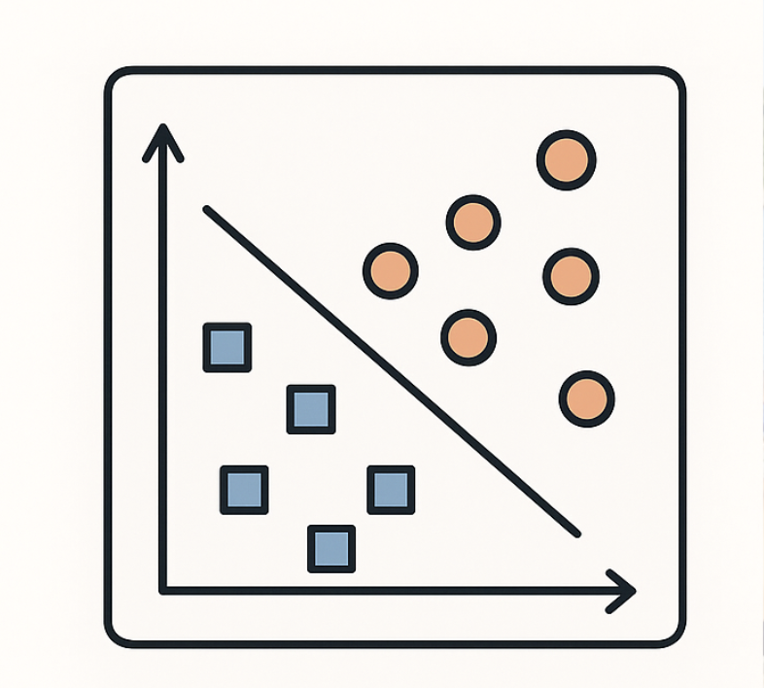
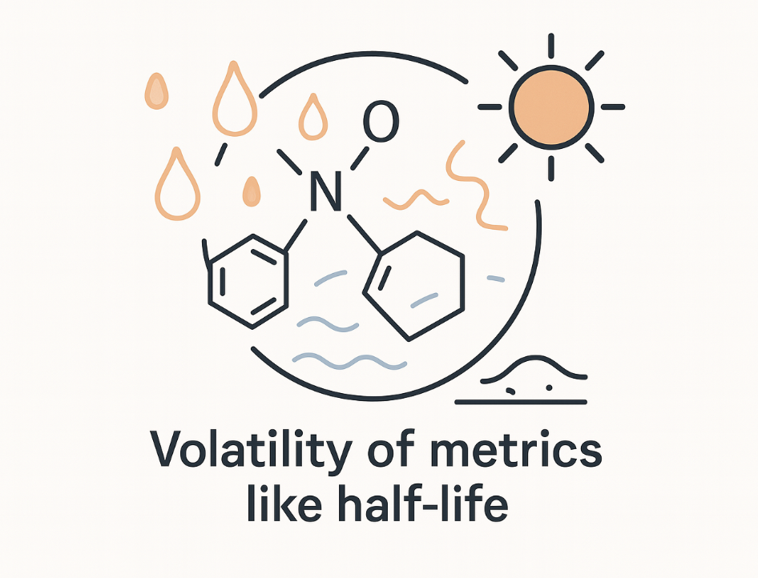

3. Limitations of Previous Studies
Pesti-Gen: Unleashing a Generative Molecule Approach for Toxicity Aware Pesticide Design
Focused mainly on classification/regression
Lack of generative models for pesticide design
Volatility of metrics like half-life

Slide 5

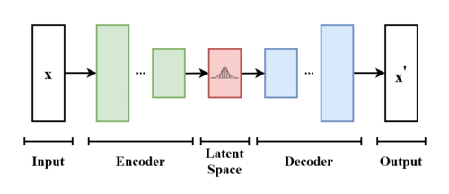
4. Proposed Solution: Pesti-Gen Framework (Generative Molecule Approach)
Taehan Kim and Wonduk Seo
Generative approach using Variational Autoencoder (VAE) [1, 2]
Two-stage model training:
1st Stage: General chemical structures learning (pre-training)
2nd Stage: Toxicity-specific fine-tuning
[1] Kingma, D. P., & Welling, M. (2013, December). Auto-encoding variational bayes.
[2] Gómez-Bombarelli etal. (2018). Automatic chemical design using a data-driven continuous representation of molecules. ACS central science, 4(2), 268-276.

Slide 6

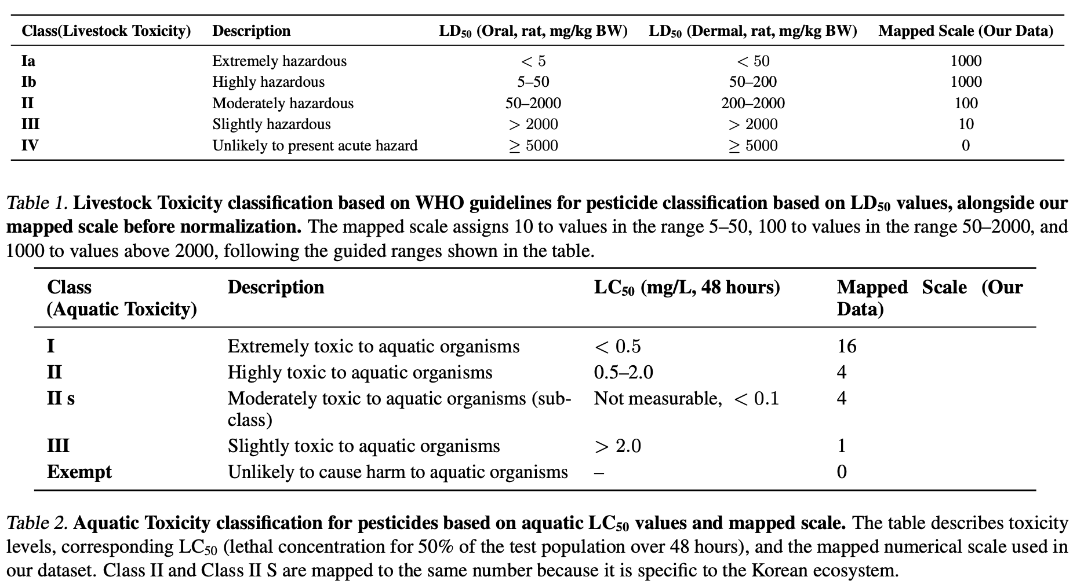
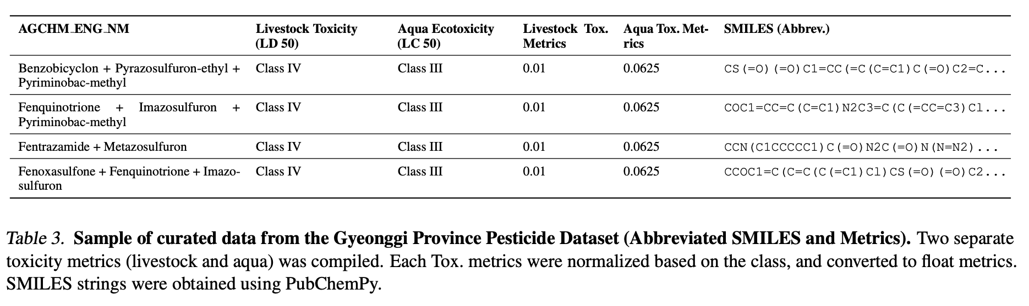
Pesti-Gen: Unleashing a Generative Molecule Approach for Toxicity Aware Pesticide Design
5. Dataset Creation and Metrics
Custom dataset based on LD50 (livestock toxicity) and LC50 (aquatic toxicity)
Data sources: (1) WHO and (2) Korean governmental databases
Data size: 56,360 data points, 520 unique pesticides

Slide 7
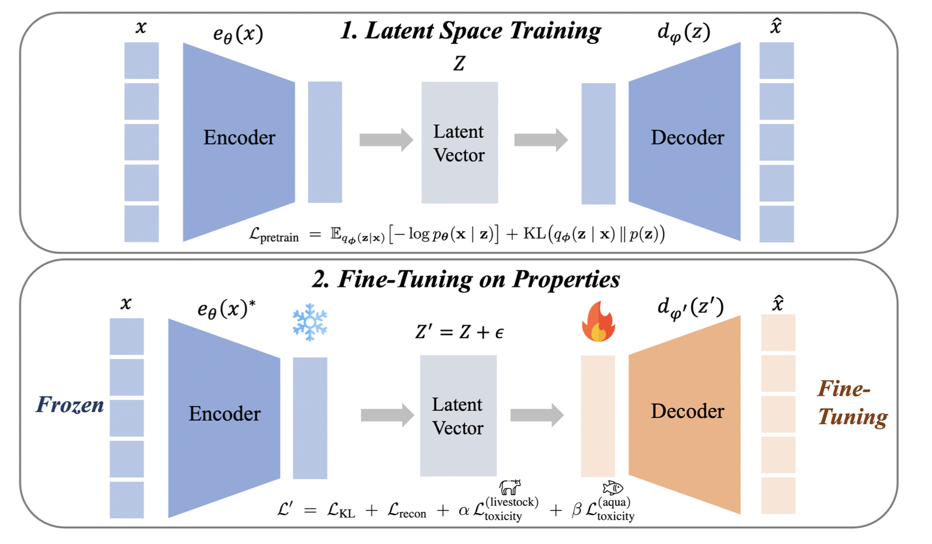
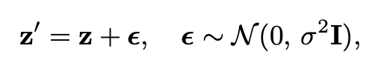
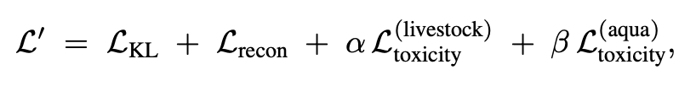
6. Methodology - Training and Fine-tuning
Taehan Kim and Wonduk Seo
1st Initial latent space training: Reconstruction and KL divergence loss using ZINC dataset [3]
2nd Fine-tuning with fixed encoder, adjusted decoder incorporating toxicity constraints with customized dataset
[3] Irwin, J. J., & Shoichet, B. K. (2005). ZINC− a free database of commercially available compounds for virtual screening. Journal of chemical information and modeling, 45(1), 177-182.

Slide 8

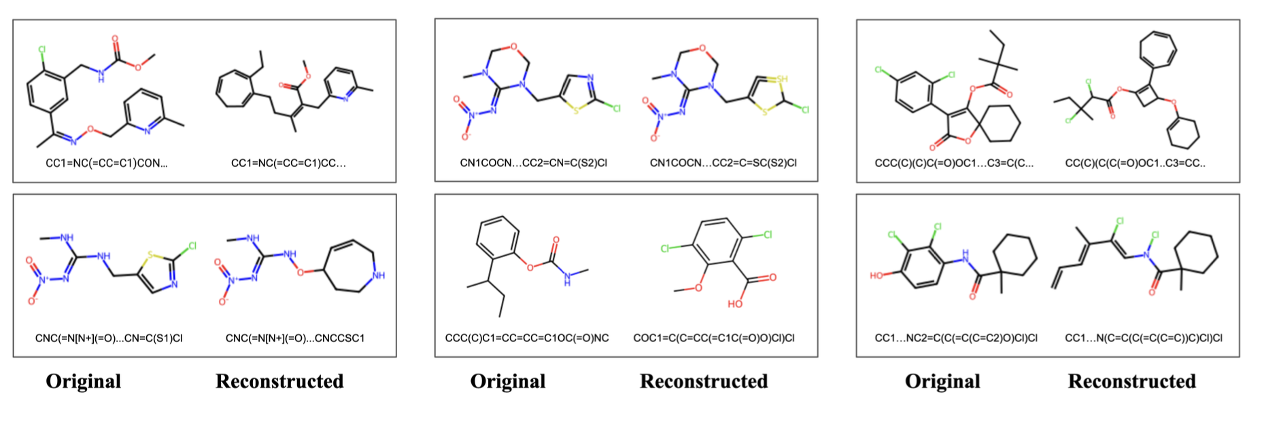
7. Experimental Results - Structural Validity
Pesti-Gen: Unleashing a Generative Molecule Approach for Toxicity Aware Pesticide Design
SMILES validity rate: ~68%
Novel molecular structures with chemical plausibility
.

Slide 9
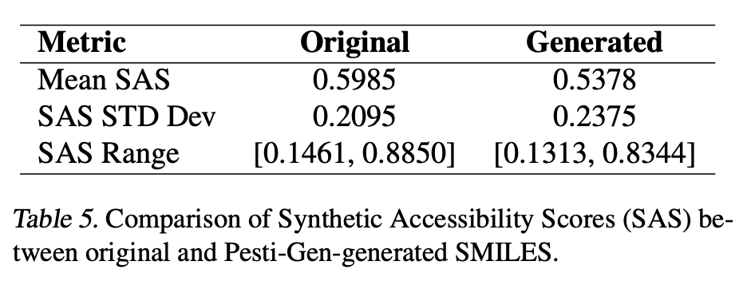
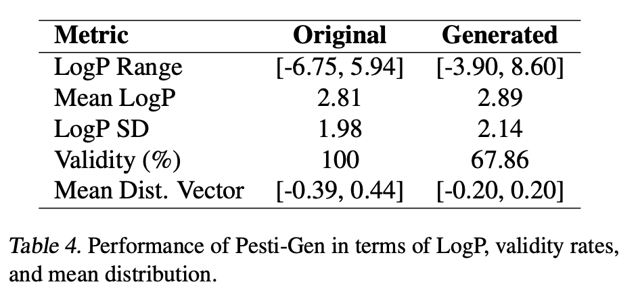
8. Experimental Results - Physicochemical Analysis
Taehan Kim and Wonduk Seo
LogP and Synthetic Accessibility Scores (SAS)
Generated molecules show balanced (1) chemical diversity and (2) synthetic feasibility

Slide 10

9. Conclusions and Future Work
Pesti-Gen: Unleashing a Generative Molecule Approach for Toxicity Aware Pesticide Design
Successful demonstration of generative pesticide design
Potential improvements: more specialized datasets, single-objective optimization
Need for wet-lab validation and expanded ecological considerations

